Slide 1


Week - 0 Welcome to Project Management with Agile Project Management with Agile Dr. Bhuvan UNHELKAR IT Faculty, College Of Business; Office: C225; bunhelkar@sar.usf.edu; 941-359-4654

Slide 2
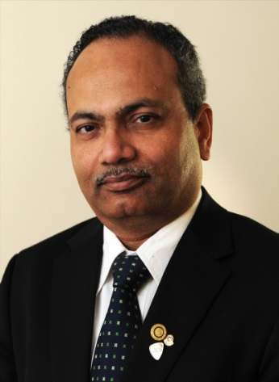
Presenter Profile - Dr. Bhuvan Unhelkar (BE, MBA, PhD, FACS, CBAP®)
Professor of IT, USF-Sarasota-Manatee; Founder, MethodScience.com & PlatiFi.com
Courses: UML, Agile PM, Big data (Hadoop/Spark, NoSQL); Designed and Presenter Australian Computer Society’s Business Analysis (BAS) and Agile PM
Visiting Faculty at UTS (Agile SW Modeling) and UWS in Sydney, Australia
Author: 20 Books (Mobile, Agile, Green ICT) – including Big Data Strategies for Agile Business
Supervisor: 7 PhD Completions;
Fellow of the Australian Computer Society; Life Member, Computer Society of India & BMA
Rotarian – Rotary club of Sarasota Sunrise; (Past President – Rotary Club of St Ives & Sarasota Sunrise, Paul Harris Fellow+6; AG); TiE x-Director
www.unhelkar.com; & www.methodscience.com

Slide 3
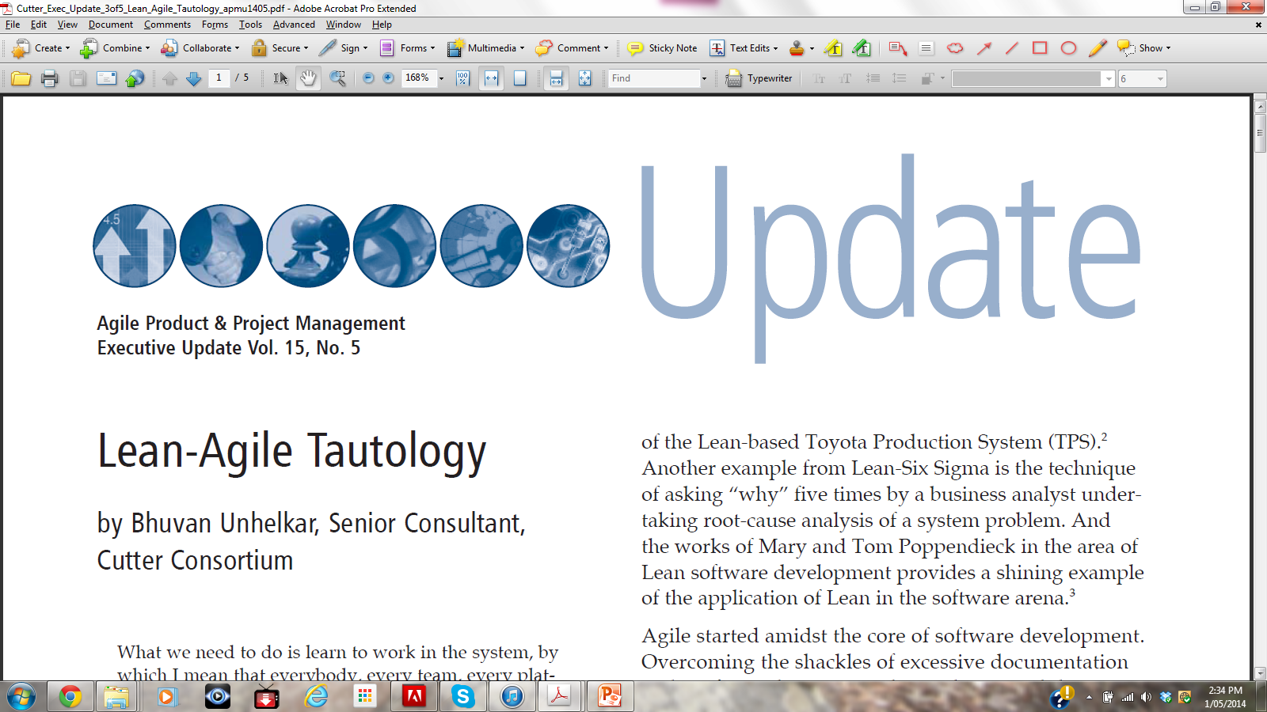
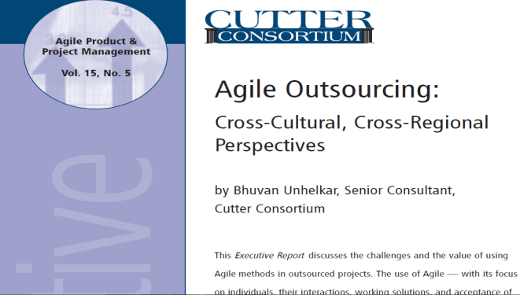
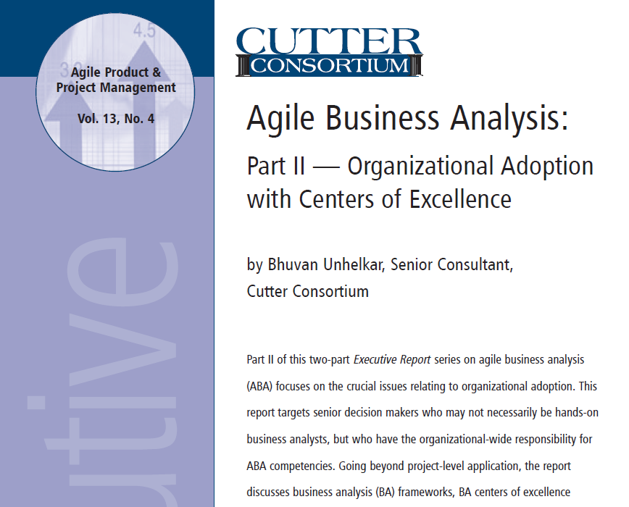
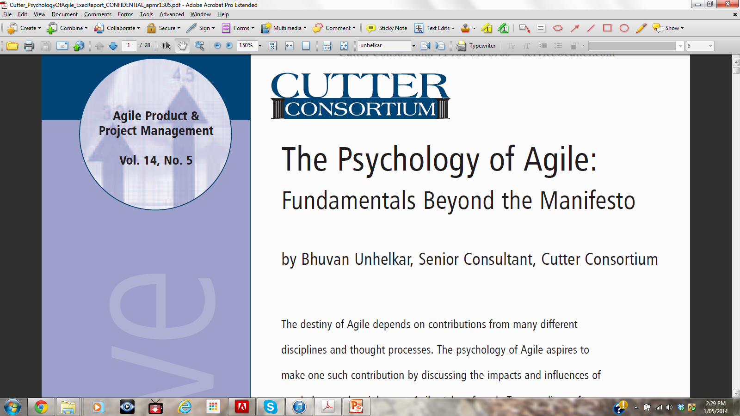

Slide 4

Learning Objectives
Undertake the basic activities of Project planning, budgeting and tracking in real-life projects using the classic (PMBOK-based) project management techniques
Recognize the importance of Agility in projects and organizational culture based on the Agile manifesto and its relevance in managing Risks
Demonstrate the use of Agile techniques used in practical projects including requirements modeling, project estimations, prioritization, tracking and quality
Undertake Collaborative Iteration planning for Agile projects and manage their visual tracking
Undertake team work and communicate effectively in a team environment to enable delivery of project outputs

Slide 5
Schedule – Subject to changes
15 Modules spread over 5 days
9 am to 4 pm
Lecture Plans:
9 am to 10:30 am (90 mins)
11:00 am to 12:30 pm (90 mins)
1:30 pm to 3:00 pm (90 mins)
3:00 pm to 4:00 pm (60 mins – Project work)

Slide 6
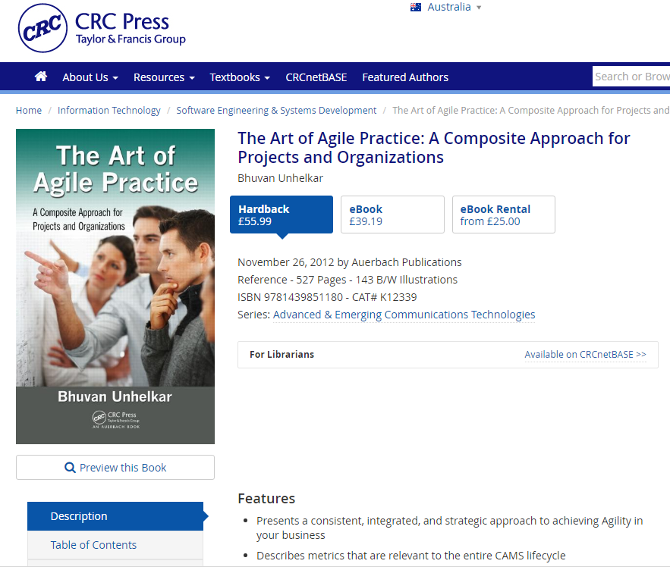
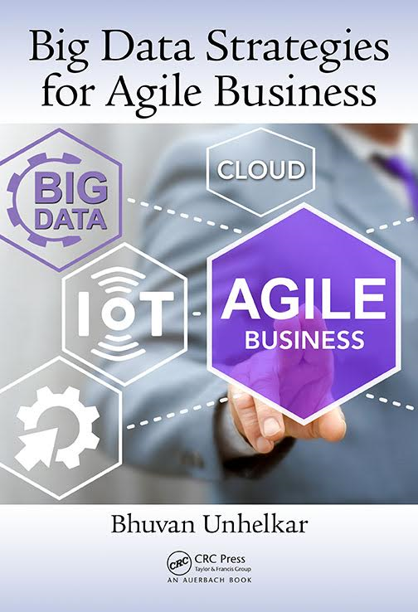

Agile – Business Analysis
Notes:
This is my most recent publication that includes many thoughts on Agile and Business Analysis – that appear later in this course.
The Art of Agile Practice: A Composite Approach for Projects and Organizations presents a consistent, integrated, and strategic approach to achieving "Agility" in your business. Transcending beyond Agile as a software development method, it covers the gamut of methods in an organization—including business processes, governance standards, project management, quality management, and business analysis—to show you how to use this composite approach to enhance your ability to adapt and respond to evolving business requirements.

Slide 7
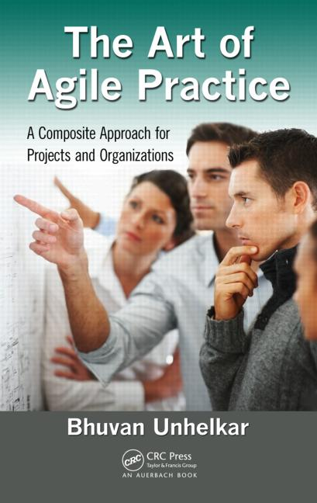
Sub-Module Certifications
Review of Existing / Popular Agile Certifications (External) and my Recommendations
Your Options and Thoughts?
© MethodScience; Material Designed and Presented by Dr. B. Unhelkar; drawn from The Art of Agile Practice

Slide 8
Background Thinking
There are number of Professional Certifications out there in the Industry related to Agile
Many a times, employers look ‘actively’ for these certifications
Even though certifications in themselves may not be enough
Certifications (external) in your Resume indicate your interest in Agile beyond academic studies
This course includes approx. 80% of the material you need to appear in a certification exam
Earning a certification is NOT an official requirement of this course
But if you can ‘double dip’ than it’s the best value for you

Slide 9
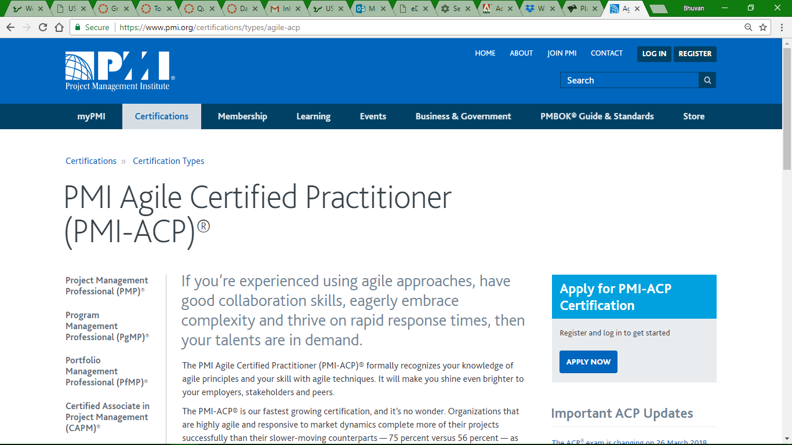

Slide 10
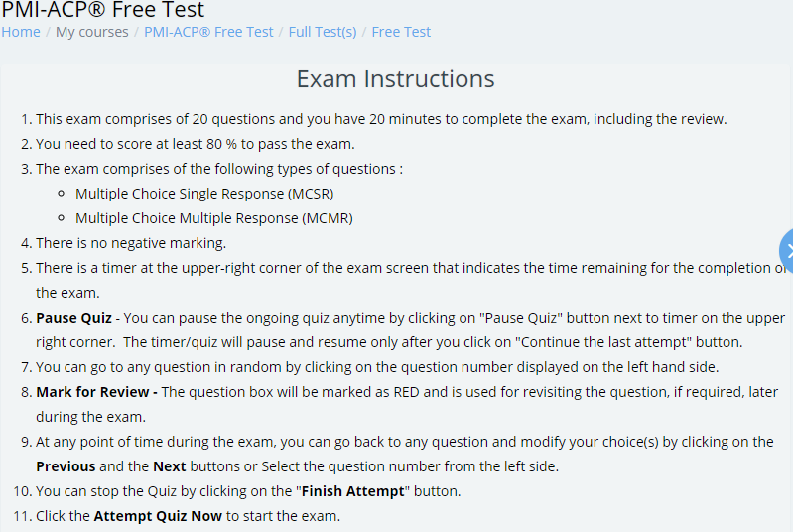
https://learning.whizlabs.com/mod/quiz/view.php?id=5240

Slide 11
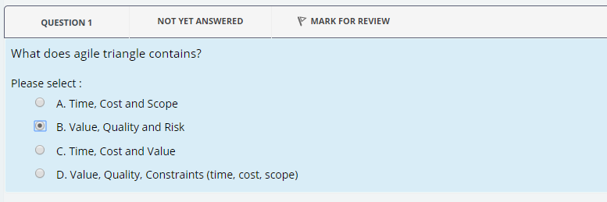

Slide 12
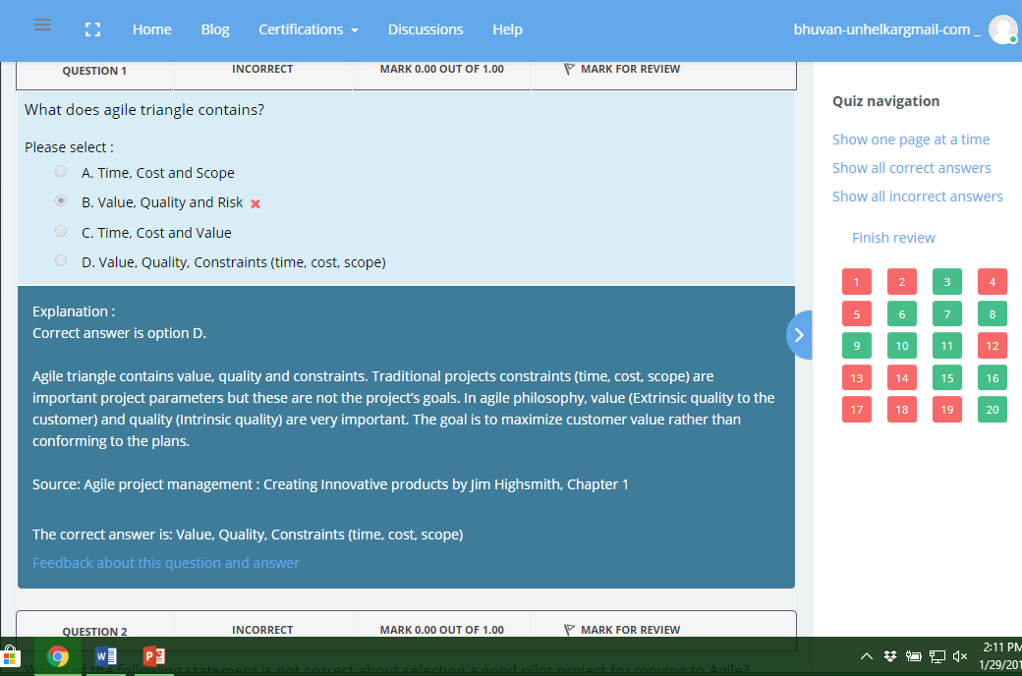

Slide 13
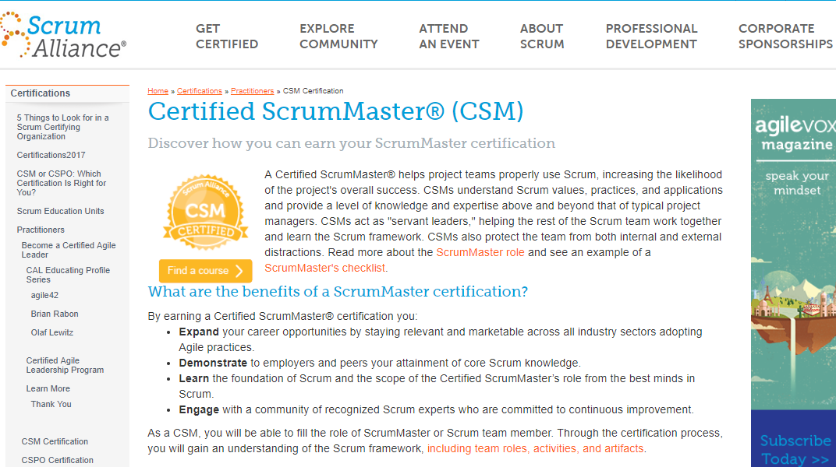

$ 1,100 for a course (Ken Schwaber)

Slide 14
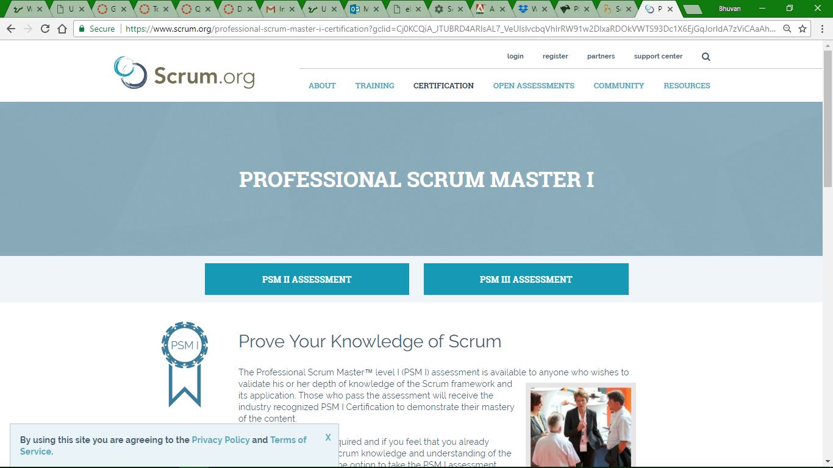
[3] Professional Scrum Master – I (Best option)

Slide 15

PSM-I (from Scrum.org)
Jeff Sutherland
No need to Purchase a Class
$150 for one attempt
PSM-II and PSM-III may not be value-for-time and value-for-money
PSM-I can be further improved upon by SAFe Certification

Slide 16
http://www.scaledagileframework.com/
SAFe 4.5 reflects the latest in Lean-Agile thinking, more visibly incorporating scalable DevOps and the Continuous Delivery Pipeline. It demonstrates advancements in configurability, implementation guidance, and enhanced capabilities for improving the user experience and accelerating time-to-market. Read more at: http://www.scaledagileframework.com/ Copyright © 2010-2017 Scaled Agile, Inc. Request permission to use text and graphics: http://www.scaledagile.com/permissions-form/

Slide 17
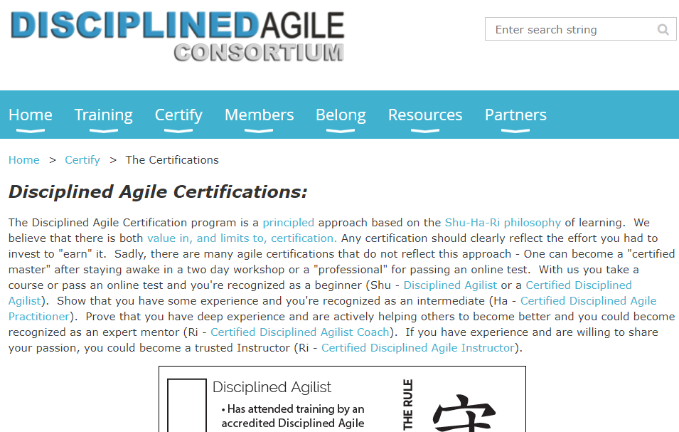
Disciplined Agilist (DAD)
https://disciplinedagileconsortium.org/certifications

Slide 18

Project Management Institute: PMI® Intellectual Property Acknowledgement
The PMI Registered Education Provider Logo is a registered mark of the Project Management Institute, Inc.
This material is currently used ONLY for academic purposes;
MethodScience earlier used this when it was a Registered Education Provider (R.E.P.) of the PMI
Some Diagrams and Materials have used the Project Management Institute’s, A Guide to the Project Management Body of Knowledge (PMBOK® Guide) – Fifth Edition
Project Management Institute, Inc., 2008
PMBOK is a registered trademark of the Project Management Institute, Inc.

Slide 20
Week - 0 CERTIFICATIONS – Optional Value from this course ISM 6930 – 3 Credit Hours Special Topics (Agile Project Management - APM) Spring, 2018; Room: A205 (12:00pm to 2:45pm) Dr. Bhuvan UNHELKAR IT Faculty, College Of Business; Office: C225; bunhelkar@sar.usf.edu; 941-359-4654

